Slide 1
Data Center Operating System (DCOS) – IBM Platform Solutions
April 2015

Slide 2
Agenda
Market Context
DCOS Definitions
IBM Platform Overview
DCOS Adoption in IBM
Spark on EGO
EGO-Mesos Integration

Slide 3














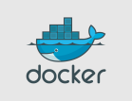




Market Context
Sea Change: CAMSS workloads are transforming both infrastructure and applications
Islands of application frameworks developing creating problems for IT (sprawl, utilization)
Emergence of Open Source projects (YARN, Mesos, Kubernetes , Docker) to address
Watson
Frameworks
IBM
Non IBM
BI
Client Requirement developing for cross framework resource management, service management and life cycle management in a shared cloud environment
YARN
Kubernetes
Emerging Layer in the Stack
EGO
Diego
Magnum
HDFS
Swarm/Compose
IaaS
IBM Systems and Cloud

Slide 4
Data Center Operating System
A Data Center Operating System (DCOS) is a technology foundation for Software Defined Infrastructure products/solutions, providing:
Resource aggregation across the data center(s)
Multi-tenancy
Policy-based sharing
Integration with multiple workload types
Supports enterprise capabilities (Reporting, GUI, HA, Security)
And delivering the following values:
Improved infrastructure utilization
Application performance and SLA

Slide 5
What is DCOS: Node Operating System Revisited
Applications
Web server, app server, database,etc
Application Middleware
System
Services
cron,nfsd,etc
C API
An operating system exists to support applications but needs to be installed, configured and managed
Services Manager
service start|stop
Memory Manager
malloc/free
Process Manager
fork/exec
File System
read/write
Device Drivers
insmod/rmmod
Setup & Configure
Hardware
OS Installer & Management Tools

Slide 6
Node OS To Data Center OS
Nodes become the resources managed by Data Center OS. Specialized hardware (storage, network switches, routers) become software services on commodity hardware.
Patterns & REST API
Distributed Services Manager
Manage long-running services lifecycle
Resource Manager
Aggregate & share resources across multiple frameworks
Remote Execution & Container
Management
Manage execution of containers (discovery, clustering, load-balancing)
Distributed File/Block/Object System
Persistent storage for applications
and services supporting multiple protocols
Node Agent
Node Agent
Node Agent
Node Agent
Device Drivers for Nodes
Node OS
Node OS
Node OS
Node OS
Hardware
Hardware
Hardware
Hardware
Virtual / Physical Hardware
IBM Confidential

Slide 7
How Data Center Operating System is used
Run-Time Execution & Workload Management
Applications
Application Frameworks, PaaS (Hadoop, CloudFoundry,Symphony)
System Services (eg Storage Protocol Gateways, NFV)
Patterns & REST API
Services Manager
Manage long-running services lifecycle
Aggregate & share resources across multiple frameworks
Resource Manager
Remote Process Execution & Container
Management
Manage execution of containers (discovery, clustering, load-balancing)
Distributed File/Block/Object System
Persistent storage for applications
and services
Node Agent
Node Agent
Node Agent
Node Agent
Device Drivers for Nodes
Node OS
Node OS
Node OS
Node OS
Virtual Hardware
Setup , Configure and Manage
Hardware
Hardware
Hardware
Hardware
IaaS
IBM Confidential

Slide 8
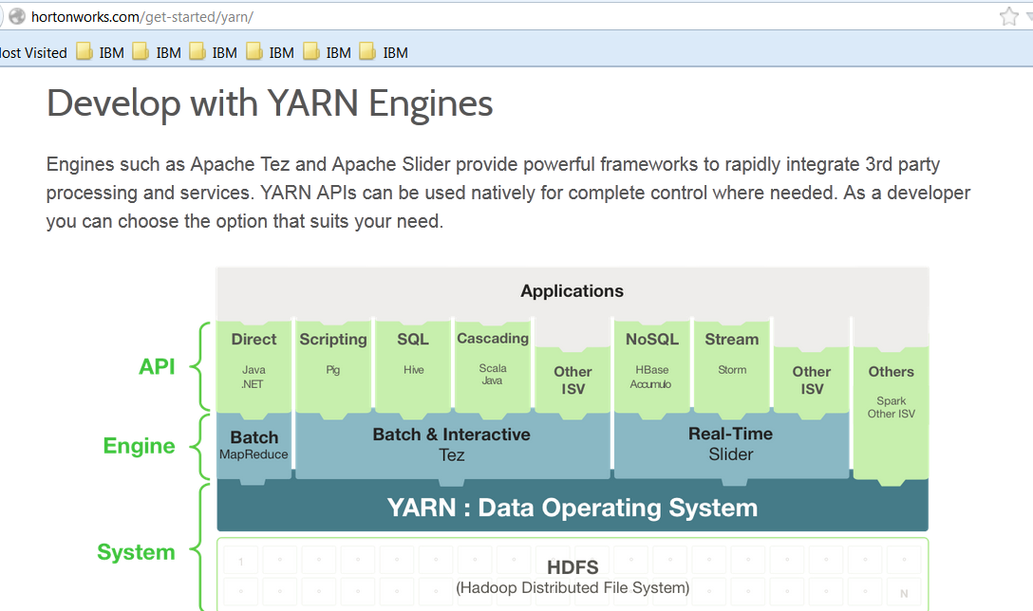
Example: YARN & Hadoop Community

Slide 9
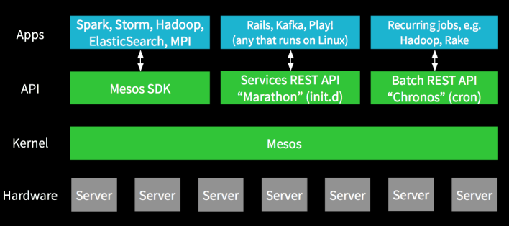
Example: Mesosphere and Mesos

Slide 10
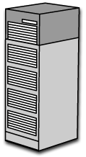
Example: IBM Platform EGO
EGO components
Platform
Application
Service Controller
Applications on EGO
EGO service controller (initd)
Platform Symphony
Platform Symphony MapReduce
Platform LSF
Platform Cluster Manager
IBM Cloud Manager
3rd Party Applications
EGO Kernel APIs
EGO core daemon (vemkd)
EGO Kernel
EGO Agents
EGO Agents
EGO Agents
EGO Agents
EGO Agents
EGO master
EGO standby master
EGO Slave
EGO Slave
EGO Slave
Notes:
EGO cluster includes several roles, EGO master, master candidate and a bound of slave nodes. There are several EGO agents running on each node responsible for resource discovery, aggregation and container execution, EGO master has a global view of all resources, defines resource group, resource sharing policies etc. EGO service control is the program running on EGO master node and responsible for long running service management. It leverages EGO kernel APIs to allocate resources on behalf of those services, then starts services on allocated nodes, then monitor those service life cycle etc.

Slide 11
IBM PLATFORM OVERVIEW

Slide 12
IBM Platform Computing
Infrastructure software for high performance applications
  20 years managing distributed scale-out systems with 2000+ customers in many industries
  Market leading workload, resource and cluster management
  Unmatched scalability (small clusters to global grids) and enterprise production-proven reliability
  Heterogeneous environments – x86 and Power plus 3rd party systems, virtual and bare metal, accelerators / GPU, cloud, etc.
  Data-aware with multiple Elastic Storage integrations
  Shared services for both compute and data intensive workloads
23 of 30 largest commercial enterprises
Over 5M CPUs under management
60% of top financial services companies

Slide 13
















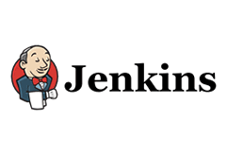








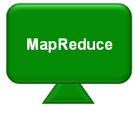
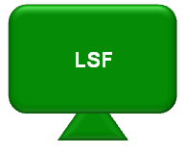
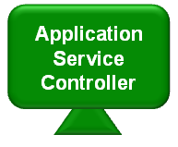


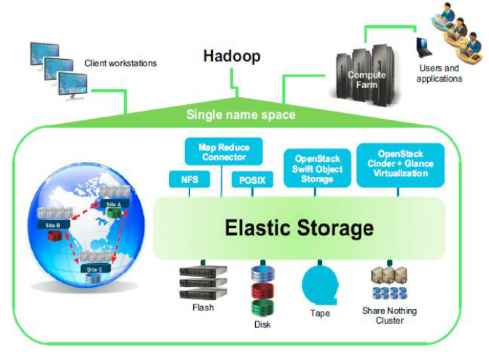




Platform Computing As Part of IBM Software Defined Infrastructure
High Performance Analytics
(Low Latency Parallel)
Hadoop /
Big Data
High Performance Computing
(Batch, Serial, MPI, Workflow)
Application Frameworks
(Long Running Services)
Traditional
Commercial
Applications
Example
Applications
&
Application
Frameworks
Homegrown
Homegrown
Other
Compute
Management Software
Software Defined Compute
IBM Platform Resource Manager (EGO/DCOS)
Software Defined Storage
Spectrum Scale (w/ LTFS) - XIV / “Purple” - SAN Volume Controller
Virtual Storage Center - Tivoli Storage Manager
On-premises, On-Cloud, Hybrid
Physical Infrastructure
x86
Linux on z
Hypervisor
Software Defined Infrastructure
Management
IBM Platform Cluster Manager
IBM Cloud Manager with OpenStack
IBM Platform Computing
Cloud Service
Bare Metal Provisioning
Virtual Machine Provisioning
SoftLayer APIs & Services

Slide 14
DCOS for IBM
IBM Confidential

Slide 15

Technology Foundation: Platform EGO
Resource Metrics Collection
CPU utilization
Number of cores
Memory
I/O
Disk space
Network
User defined
Supply: Resource Group Hierarchy
Demand: Consumer Tree
/
DB
DC
DC
App
Server
App
Server
App
Server
Rack
Group
Rack
Group
Rack
Group
Web
Server
Web
Server
Platform
EGO
Rack
Rack
Rack
Rack
Rack
Rack
Reservations & Quotas
Contract
#55
Contract # 768689
Network Costs
Offering 3
400
 | DC1 | DC2 | DC3
DC1
DC2
DC3
 | Rac K1 | Rack2 | Rac k3
R2
R2
R3
Contract # 78934
Contract
# 889
Offering 2
200
#999
Contract #888
Contract # 888
Contract
#677
Contract #677
Offering 1
300
Output
Initial Placement
- Runtime Management
- Defragmentation & Migration
Contract #123
Contract #444
Jan
Dec

Slide 16

EGO Components
Four major components
  LIM – Load Information Manager
  PEM – Process Execution Manager
  VEMKD – VEM Kernel Daemon
  EGOSC – EGO Service Controller
Clients
WS Interface
APIs
Master
LIM
VEMKD
PEM
EGOSC
LIM
LIM
LIM
Agents
PEM
PEM
. . .
PEM

Slide 17
VEMKD Overview
VEMKD is EGO Kernel
Workload Manager
Workload Manager
VEM API
EGO Master
EGOSC
VEM API
VEMKD
PLUGIN
BASE API
MLIM
TCP Socket
UDP Socket
EGO Agent
EGO Agent
EGO Agent
LIM
PEM
LIM
PEM
LIM
PEM

Slide 18
VEMKD Overview (Cont’d)
VEM API
Client Manager
Security
Manager
Information
Allocation
Execution
Allocation Manipulator
Container Manager
Info
Query
Manager
Event
Notification
Recovery
Utilities
Allocation Engine
Resource
Selector
Consumer
Manager
Resource Group
Manager
PEM Manager
Audit Logger
Data Logger
Service
Manager
Resource Broker
LIM
PEM

Slide 19
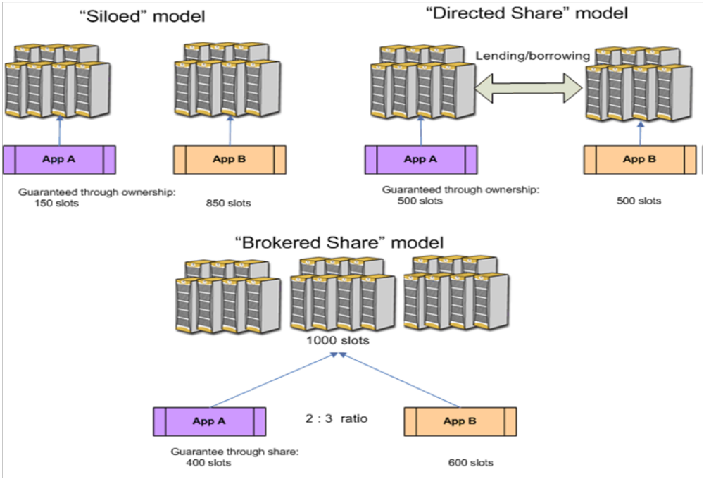
EGO Resource Sharing Policies
Illustration of three shared-resource models
A combination of all three models can be managed within a single grid at the same time!

Slide 20
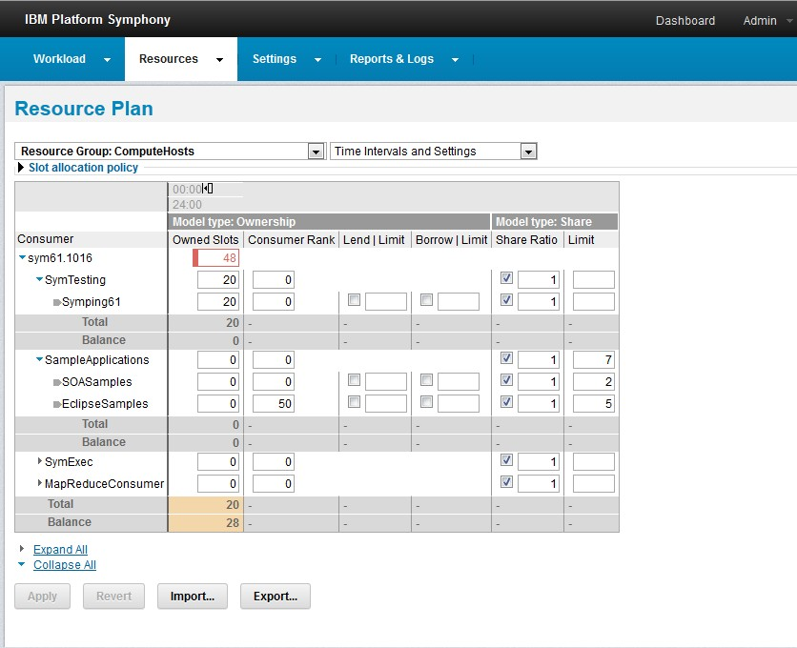
EGO Resource Sharing Policies (Cont’d)

Slide 21
EGO Resource Sharing Policies (Cont’d)
EGO Scheduling Policies
  Ownership
  Borrow/Lend
  Dynamic share
  Hybrid
  Multiple Dimension Scheduling (Improved DRF, Patented)
  Standby Service
  Smart Reclaim
  Resource Group Preference
  Topology Aware Scheduling

Slide 22
APIs
Pseudo code of a sample client program that does ask EGO for some resource and start some “work”.
  handle = vem_open(…)
  vem_logon(handle, user, password) # authenticate client to EGO
  vem_register(handle, …) # register client and callbacks
  allocationID = vem_alloc(handle, allocationSpec…) # asks for some resource
  containerID = vem_startcontainer(handle, allocationID, host, containerSpec, …)
  vem_allocfree(handle, allocationID) # free allocation
  vem_unregister(handle, …) # unregister
  vem_logoff(handle)
  vem_close(handle)

Slide 23
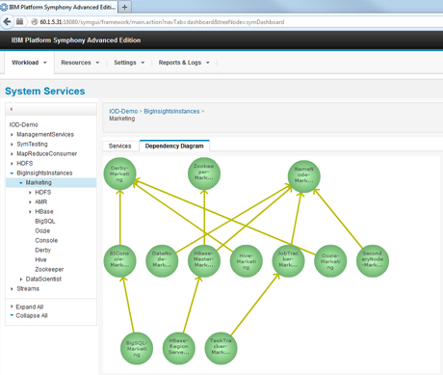
DCOS for Platform: Application Service Controller( ASC)
A Service Controller for complex long running services
Service and Application definition
Service life cycle management
Complex service dependency
HA, Persistency, virtual IP
Elastic service pool
Auto-scaling
Multiple triggers for grow/shrink
Dynamic services deployment
Unified resource management
Resource sharing among long running services and tasks/jobs
Stateful vs. stateless services
API & scriptable interface
Examples:
App servers
Big Insights instance, Streams, Hbase, Oozie, Native SQL apps, Mongo DB, Cassandra
IBM Confidential

Slide 24
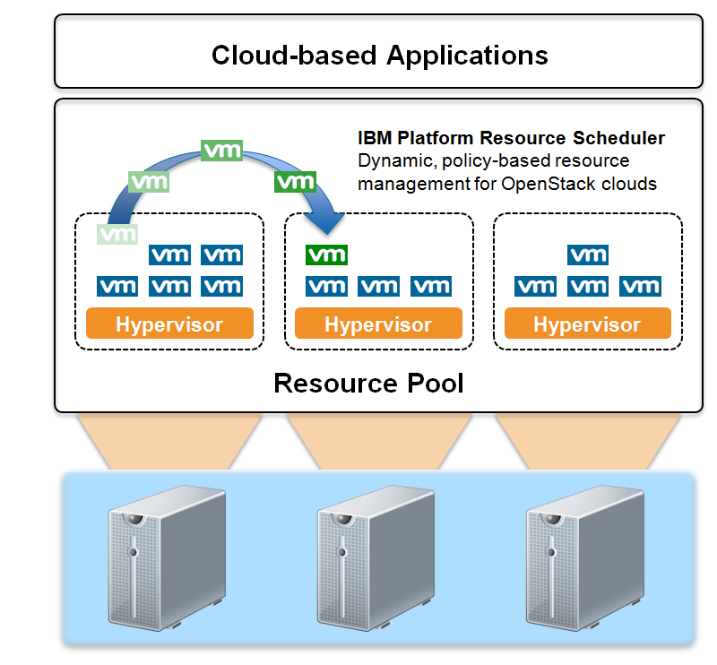
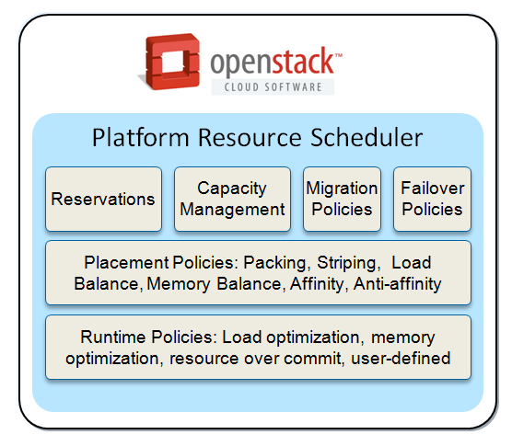
DCOS for OpenStack: Platform Resource Scheduler
  Provides dynamic resource management for IBM OpenStack clouds
    Automated management
    Reduce Infrastructure costs
    Improved application performance and high availability
    Higher quality of service
    More flexible resource selection
  Intelligent placement – automated, runtime resource optimization
  Included as optional scheduler and optimization service in ICM 4.2
  Included as a chargeable add-on product for IBM SmartCloud Orchestrator 2.4
  Full compatibility with the Nova APIs and fits seamlessly into OpenStack environments
  Part of IBM SDE portfolio

Slide 25

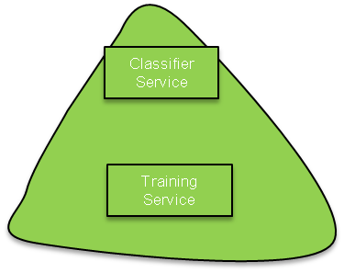


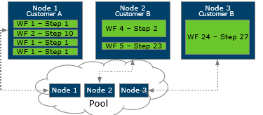
DCOS for Watson
Value Watson QA:
High availability and intelligent scheduling of long-running QA services
Improved multi-tenancy and higher utilization
Value Watson Ingestion:
Better application performance through low-latency task scheduling of ETL
Improved multi-tenancy and higher utilization
Bluemix
Watson QA
Zuul
Watson Ingestion
Zuul
Ingestion Front-End Service
Zuul
Alchemy CSF
Ingestion Front-End Service
QA REST API
QA REST API
Admin GUI
Classifier
Service
Admin GUI
Classifier
Runtime
Application Service Controller (ASC)
Classifier
Service
Classifier
Runtime
Symphony SOAM
Classifier
Service
Classifier
Runtime
Classifier
Training
Classifier
Training
Tenant #1
EGO
Classifier
Training
EGO
Tenant #2
Tenant #N
EGO Agents
EGO Agents
Spectrum Scale (Future)
Spectrum Scale (Future)
Watson QA Resources
Docker Registry
Watson Ingestion Resources
IBM Confidential
Notes:
Questions:
Will Container Service leverage EGO only for allocation/placement or also for the execution of containers (integrated with Neturon/Cinder)
If leveraging EGO execution capabilities then need to tie in either HEAT or Swarm into EGO. EGO will do both the placement and execution of containers through EGOSC. If only using EGO for allocation/placement of containers then we have to use existing Nova scheduler integration with EGO and rely on Nova-Docker to handle the execution.

Slide 26
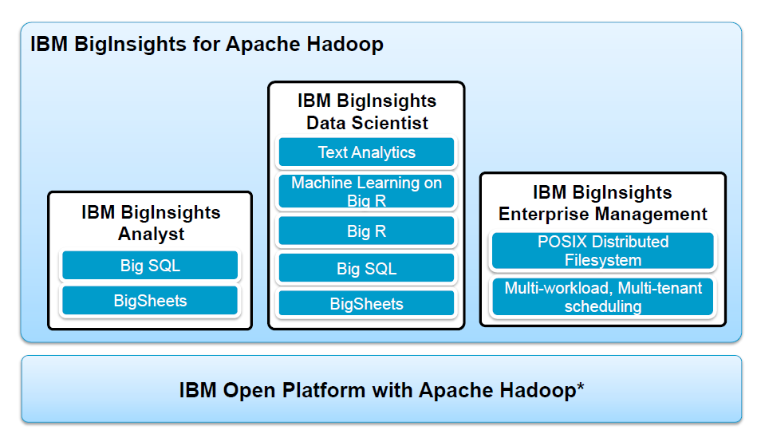
DCOS for Hadoop

Slide 27






DCOS for Spark
Self-Service Portal
Tenants Creating and Provision
Spark Cloud Tenants
Spark Cloud Management Portal ( ASC)
Spark Cloud Tenant -1
Spark Cloud Tenant -2
Analysis portal
Scala Notesbook
Shared within tenants
Zeppeline
GUI Engine
Zeppeline
GUI Engine
Spark Engine
Share Spark Context
And scheduling Job
Within Spark EGO
Spark On EGO
Spark On EGO
Executors
Executors
Resource Management
Fine-grained scheduling
Reclaim and Share
Among tenants
Executors
Executors
EGO Resource Orchestrator

Slide 28
Spark on EGO
IBM Confidential

Slide 29
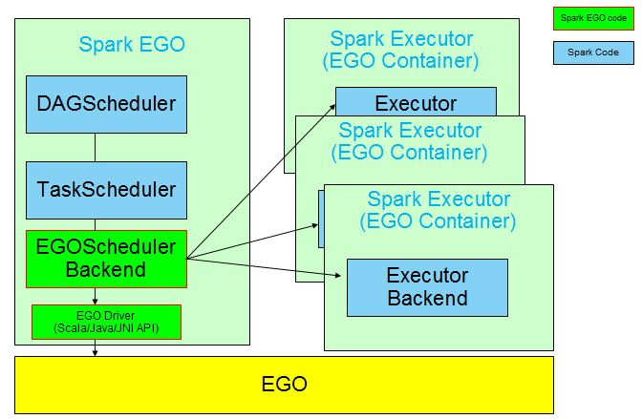
Spark EGO Scheduling Plug-in

Slide 30
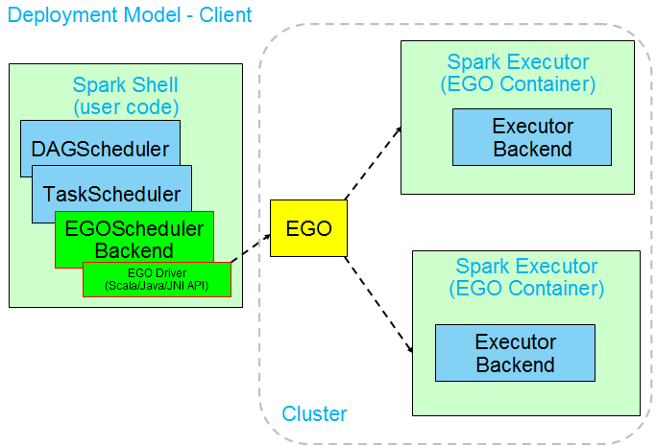
Spark Client Mode

Slide 31
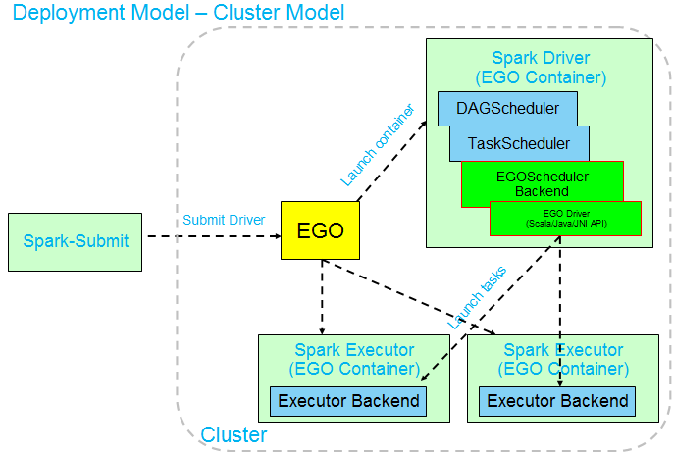
Spark Cluster Mode

Slide 32
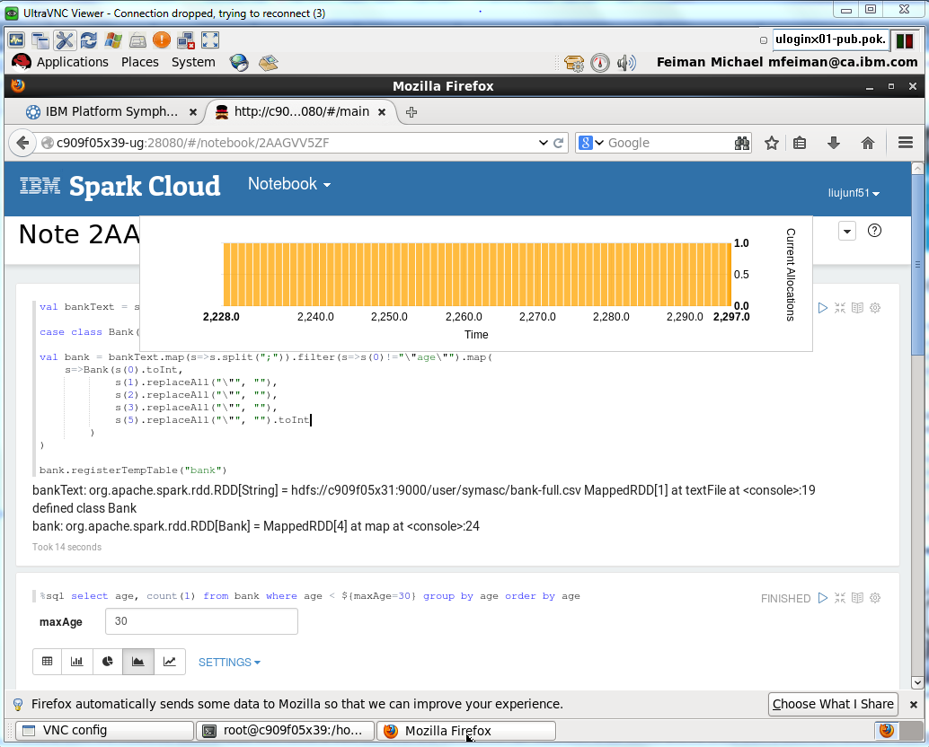
Spark Cloud End to End solution for Strata Demo

Slide 33
EGO-Mesos Integration (Research)
IBM Confidential

Slide 34
Mesos / EGO
Motivation
  Connect Platform Symphony/EGO to the quickly growing Mesos ecosystem
  Provide Mesos users with access to enterprise-strength resource scheduling
  Explore improving efficiency and latency of scheduling complex applications in large and distributed data centers
Mesos much less mature than EGO
  Mesos supports a single simple scheduling policy (DRF – dominant resource fairness)
  ”Unlike universities, we don’t care about fairness. We have a business to run”
  John Wilkes, Google Omega
  One Mesos framework can grab all resources by running long tasks, even with DRF (when other frameworks are idle)
  New ‘dynamic reservation mechanism’ in Mesos makes this even worse
  Basically, no centralized administration of cluster policies
  No support for organizational hierarchy, ownership/lending/borrowing, time-based resource planning, pre-emption, priority, load-balancing, packing/striping, etc, etc.
  However, Mesos provides plug-in mechanism for replacement of “resource allocator”
EGO policy mechanism allows for
  Performance / QoS protection for important workloads, service jobs, time-sensitive interactive tasks
    Ownership / reservation, lending with reclaim,
    Balanced job distribution, packing, striping,
  Support for organizational policies
    Consumer trees, parent policies,
  Flexible resource management
    Lending / borrowing, shared pools,
    Time-based resource plans
    Resource rank

Slide 35
Accomplishments
Integration architecture is defined, EGO policies mapped to Mesos tools
Basic EGO module in Mesos master is developed
  Uses old plug-in mechanism (C++, with Mesos recompile)
  Demos two EGO features: Time-based policies, and share ratio setting via Management Console
Currently work on a basic benchmark, based on Spark/Mesos, to demo these new features

Slide 36
Mesos / EGO: Integration outline
Platform Management Console
Framework
Framework
Mesos master
EGO Kernel
(vemkd)
RM plugin
Mesos slave
Mesos slave
Mesos slave
Mesos slave

Slide 37
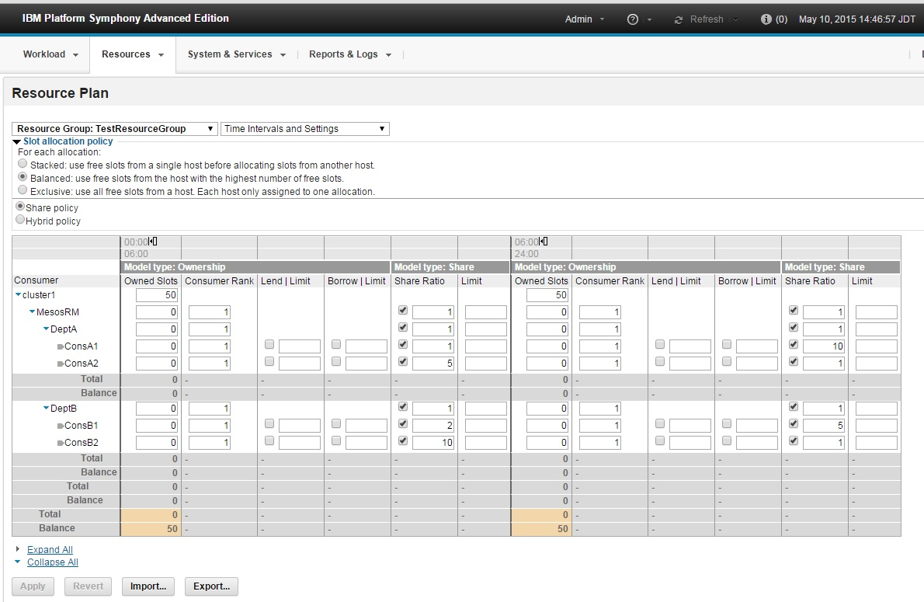
EGO Platform Management Console for Mesos++

Slide 38
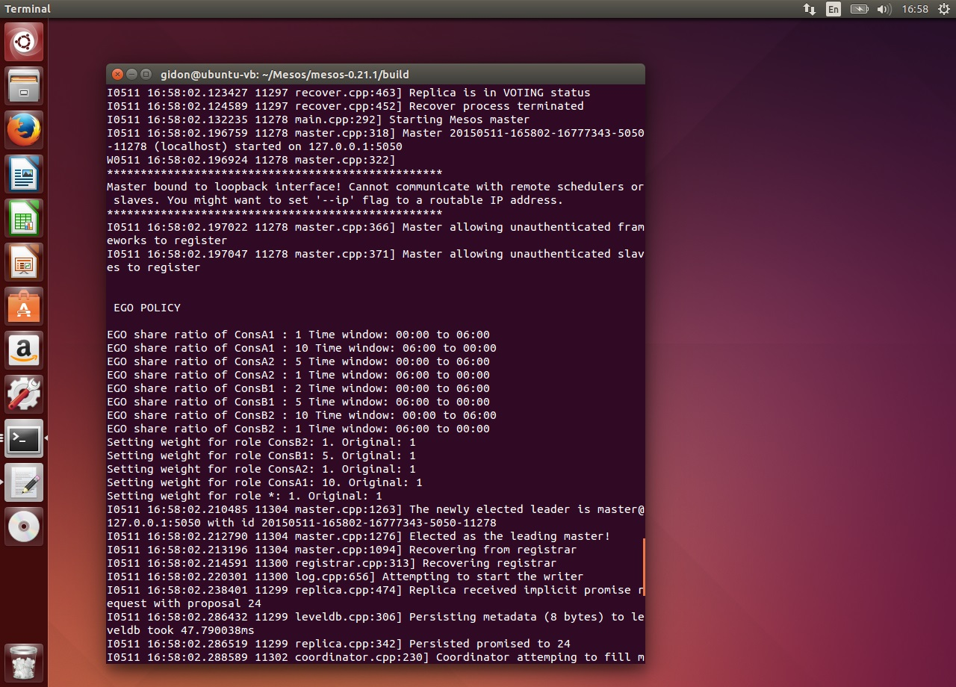
EGO module in Mesos master

Slide 39
Future Work
Demo Spark/Mesos with the sample EGO features
Upon Mesos 0.23 release, rewrite EGO module, implement all EGO policy features
Design new benchmark, comprised of Batch and Service jobs, to demo full EGO functionality

Slide 40
  苏磊 Lei Su
  suleibj@cn.ibm.com

